Slide 1







SELAMA PERKULIAHAN MEDIA YANG DIGUNAKAN!!!!
Whats uo
This Photo by Unknown Author is licensed under CC BY-SA
This Photo by Unknown Author is licensed under CC BY-SA
This Photo by Unknown Author is licensed under CC BY-SA-NC
This Photo by Unknown Author is licensed under CC BY
This Photo by Unknown Author is licensed under CC BY
This Photo by Unknown Author is licensed under CC BY-SA

Slide 2

Konsep dasar etika pelayanan

Slide 3
Konsep etika, moral dan etiket
ETIKA
MORAL
ETIKET

Slide 4
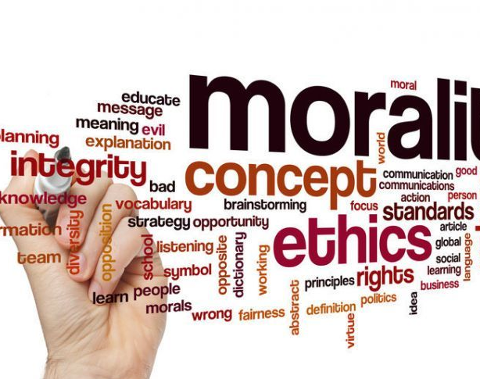
Isu-isu umum terkait etika dan moral
Notes:
Consider talking about:
Childhood
Early influence
Education
Family fortunes
Spanish flu pandemic of 1918
Early flying experiences

Slide 5

Etika dalam Kepustakaan dan Kearsipan?

